Slide 1
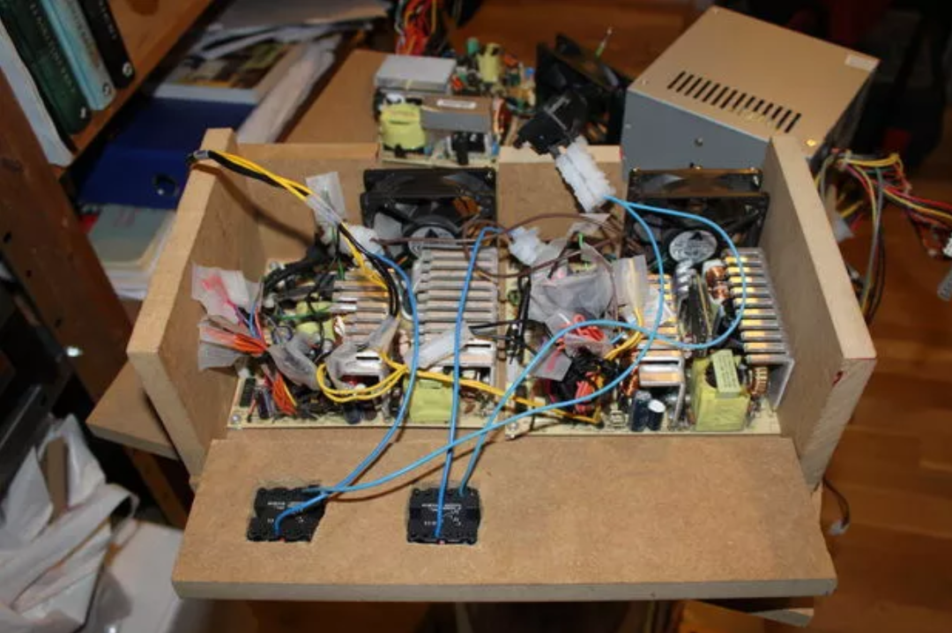
Power Supplies 101 Lab
4-Jan-2018

Slide 2
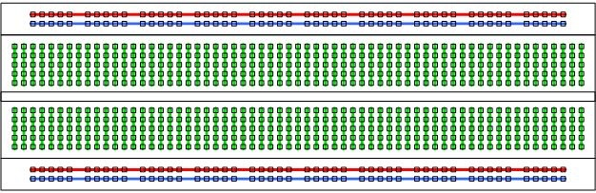
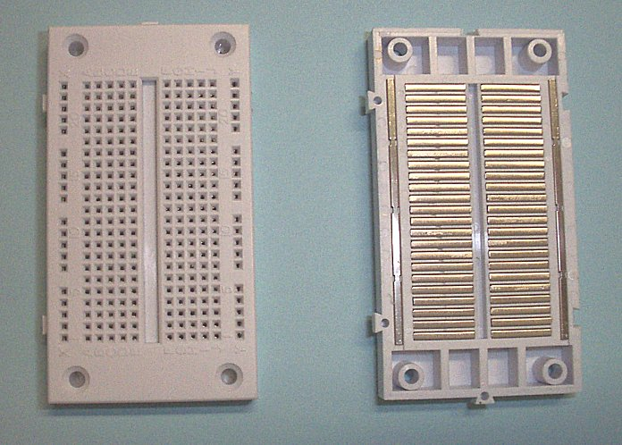
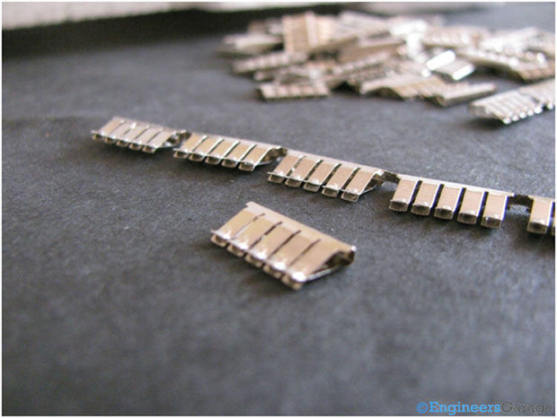
Using a breadboard
Circuit connections
Power supply buses
Internals of board

Slide 3
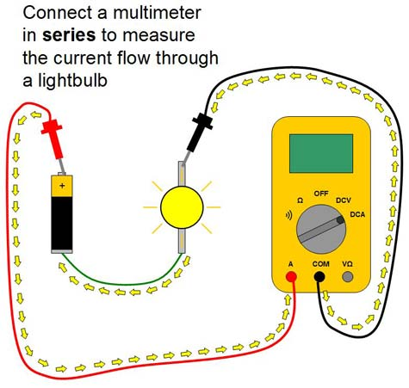
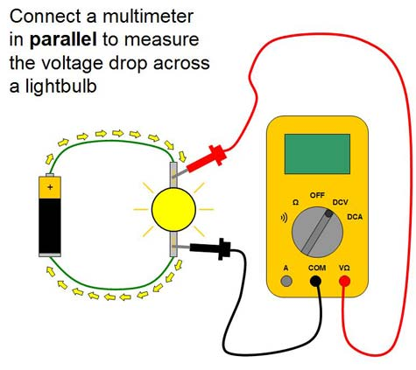
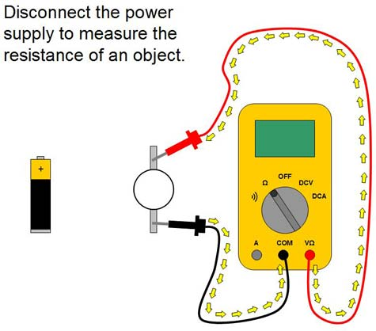
Using a Multimeter
Voltage across
Current through
Resistance of
Continuity of

Slide 4
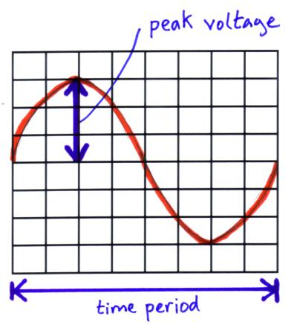
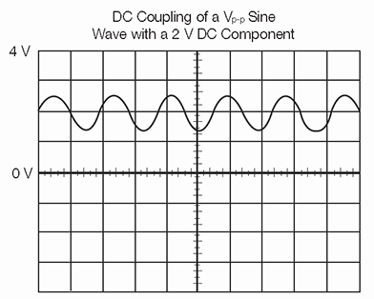
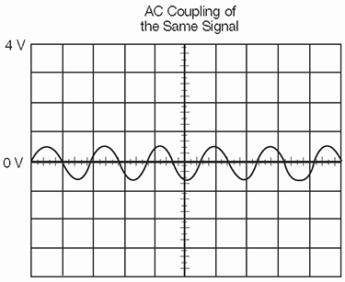
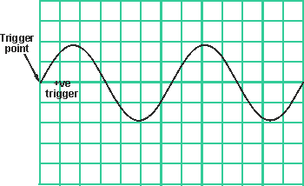
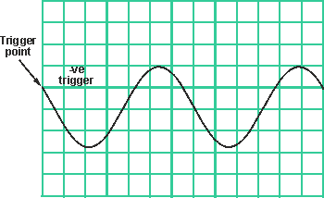
Using an Oscilloscope
Axes
Coupling
Triggering
Cursors
Measuring
AC
DC

Slide 5
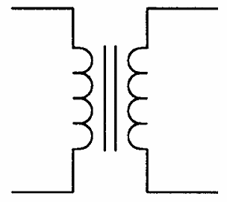
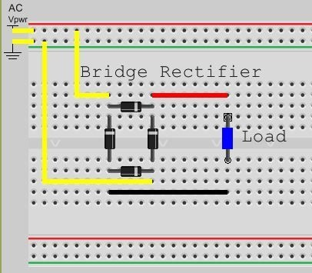
Build your AC-DC supply!
I_{LOAD} = V_{LOAD} / R_{LOAD}
+
C
120V
R_{LOAD}
Watch polarity:
Diode stripes
Capacitor +/-
Experiment with it
Change R_{LOAD}
Change C

Slide 6
Isolated supplies
Isolated Supply
#1
+
Some supplies have isolated outputs
Also called galvanic isolation
Provides safety
Reduces noise between circuits by avoiding hard connected ground nodes
Supplies can be added or subtracted by connecting them:
e.g. Two +5V supplies can be turned into +/-5V
Try it out! More detail on how switch mode supplies work
+
12V
-
17V
Isolated Supply
#2
+
120V
5V
-
-
6

Slide 7
Bored? Try this bipolar supply:
-10VDC
+
Watch capacitor polarity!
+10VDC
+
120VAC
10VAC
7

Slide 8
Bored? Try this doubler:
+100µF
+
+
20VDC
120VAC
10VAC
+100µF
This is sort of a variant of a “charge pump” or “flying capacitor” converter which is an inductor-less boost converter. This is a simple circuit for low current x2, x4, x6, etc. or inverting conversion.
In a DC circuit you could run an oscillator (e.g. 555 timer) and feed it into a couple of diodes and caps to generate a negative supply such as -5V from +5V.
A free pin on an Arduino could feed a charge pump (tone(1000)).
8

Slide 9
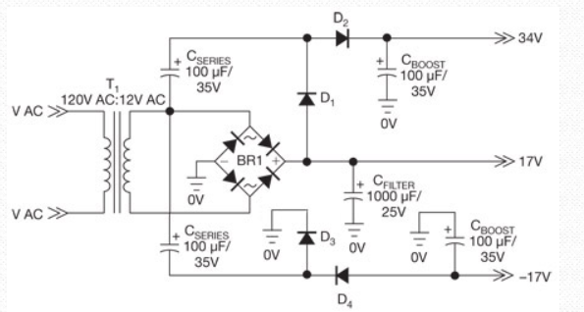
Bored? Try some of all of this:
9

Slide 10
Bored? Try some of all of this:
10

